Slide 1
In this dataset the analysis can be done for a particular company regariding data science job role. Accenture has Highest Number of Data Science Job Role in their Company. We cannot exactly specify that there are more data engineers because the role of data analyst in subdivided into many sub categories.it shows that there are more data engineer employee in Accenture. Bangalore has Highest number of data science Jobs. IT Skills and Python are the two main skill mentioned in data science Job role The Applicant must required above 10 years experience to be a head or Director of a Company. To acquire a senior position the applicant should have 1-3 years of experience. More detailed analysis can be done about a particular company.

Slide 2
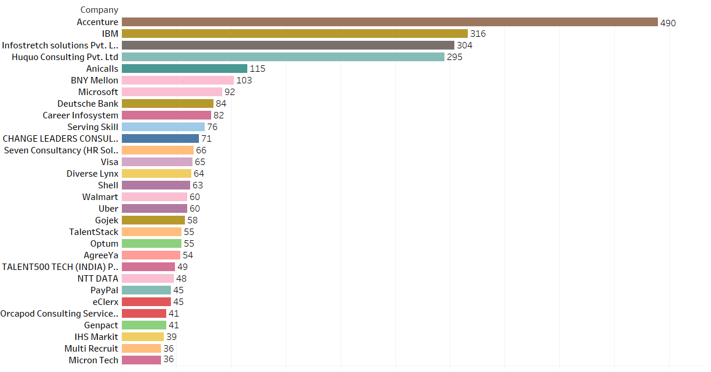
Accenture has Highest Number number of Data Science Job Role in their Company.

Slide 3
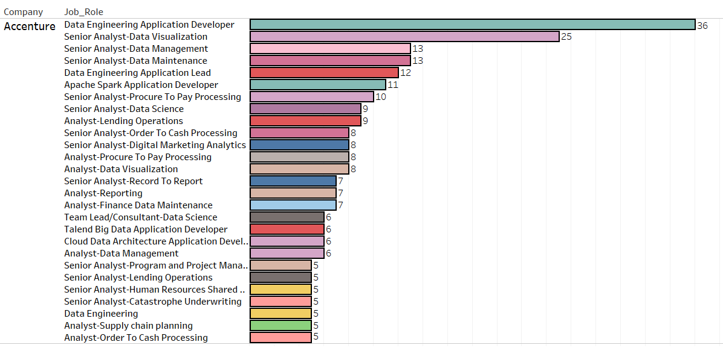
We cannot exactly specify that there are more data engineers because the role of data analyst in subdivided into many sub categories.it shows that there are more data engineer employee in Accenture.

Slide 4
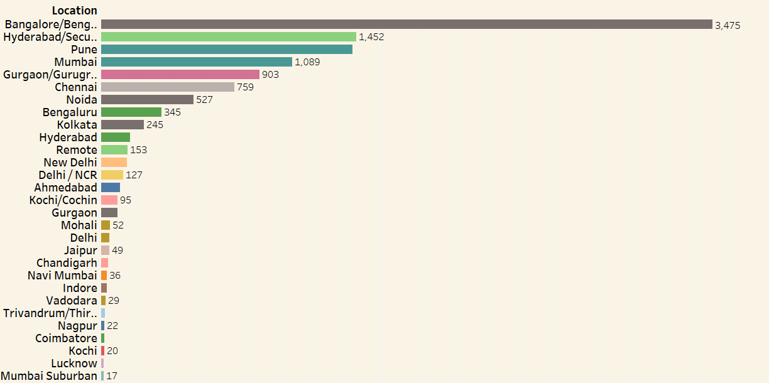
Bangalore has Highest number of data science Jobs.

Slide 5
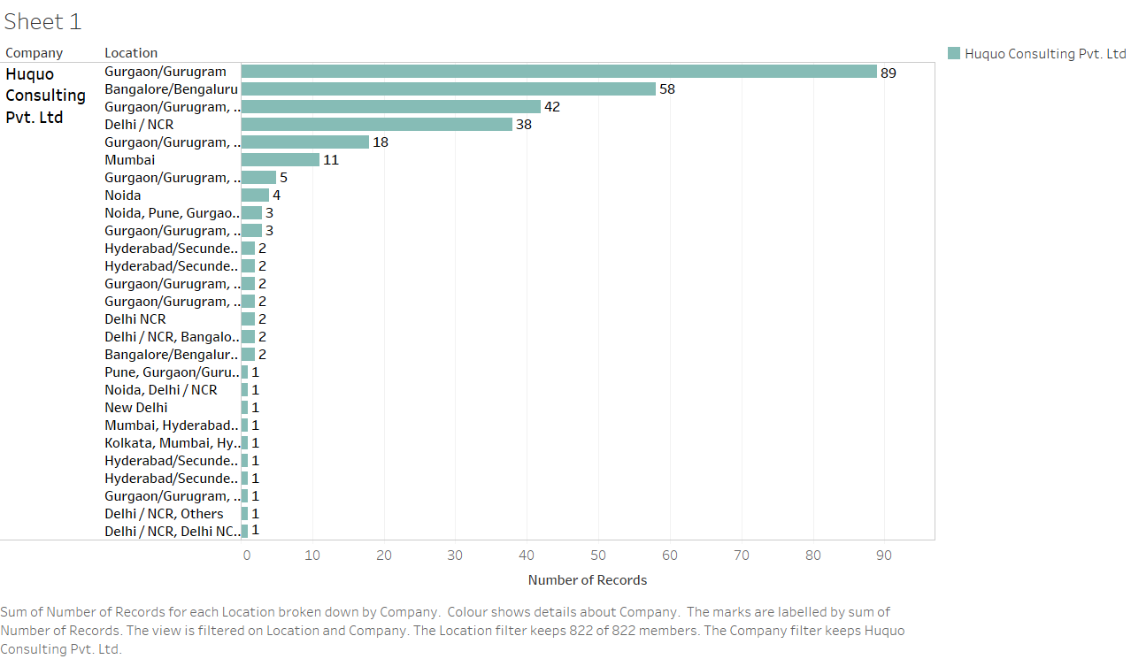
Huquo Consulting Pvt. Ltd has highest number of Branches all over India.
Banglore has highest number of companies.

Slide 6
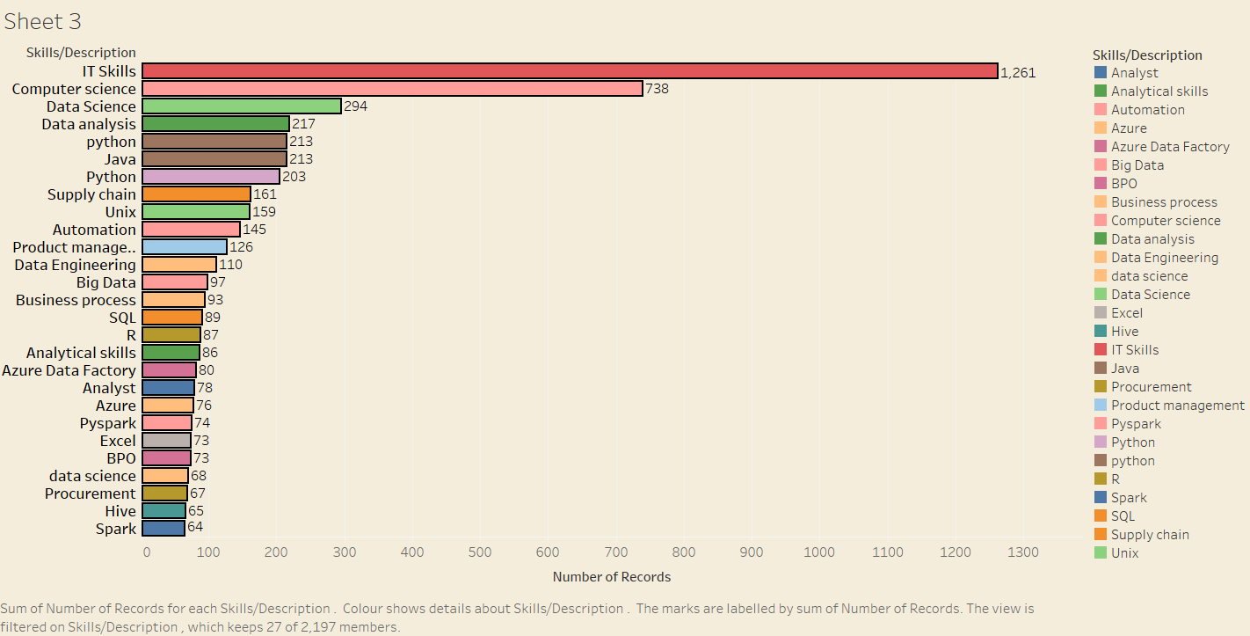
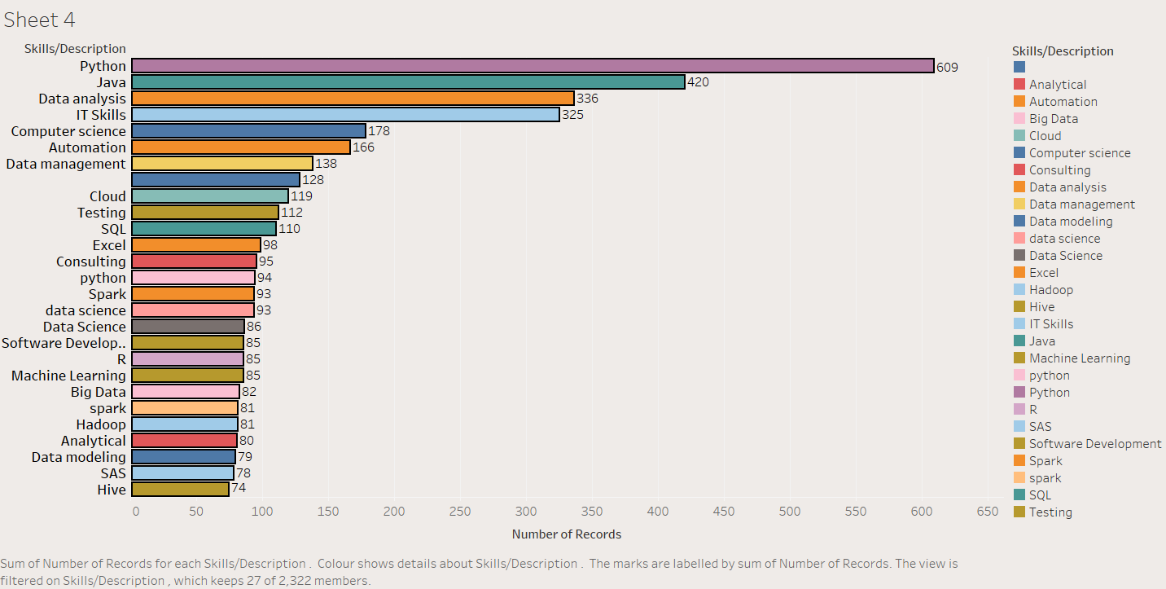
IT Skills and Python are the two main skill mentioned in data science Job role. To know what exact skill is required for a Particular Job role visit this link = https://github.com/vaibhavtt24/Naukri-Data-Science-Jobs/blob/main/Naurkri%20Data%20Science%20Skills.pdf

Slide 7
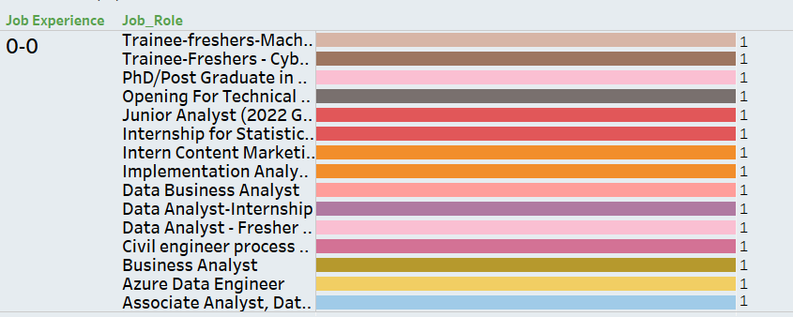
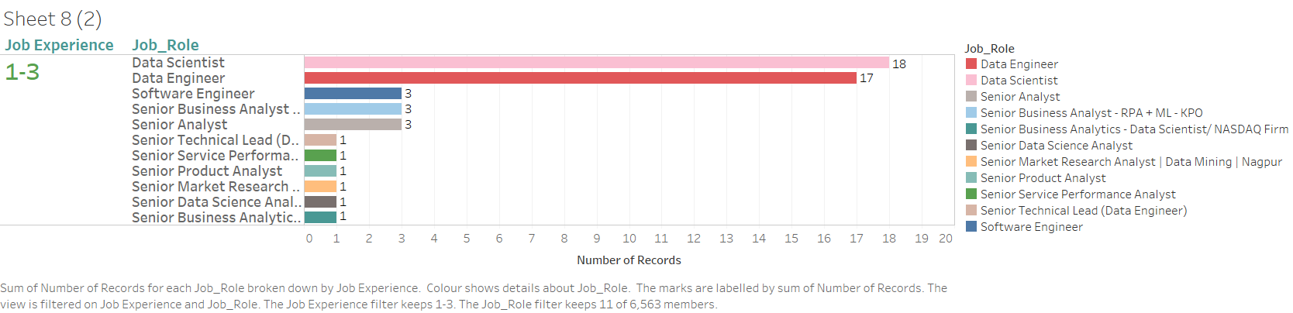
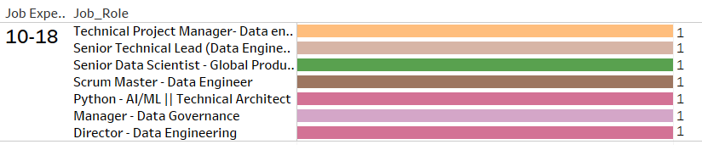
The Applicant must required above 10 years experience to be a head or Director of a Company. To acquire a senior position the applicant should have 1-3 years of experience.

